Slide 1
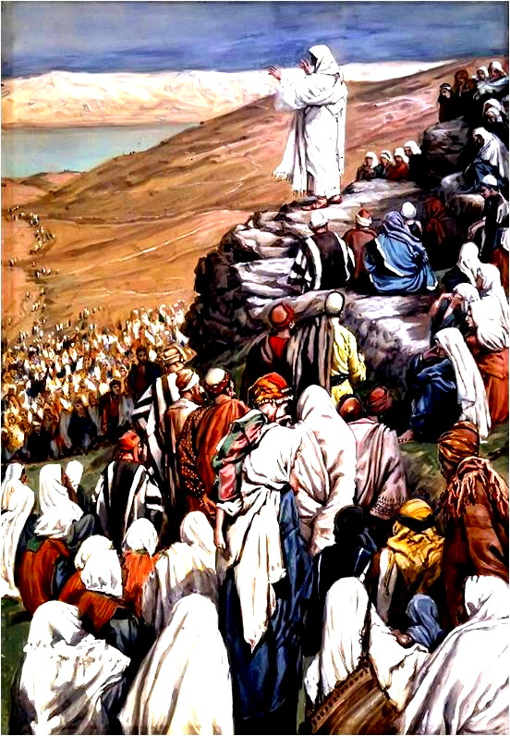
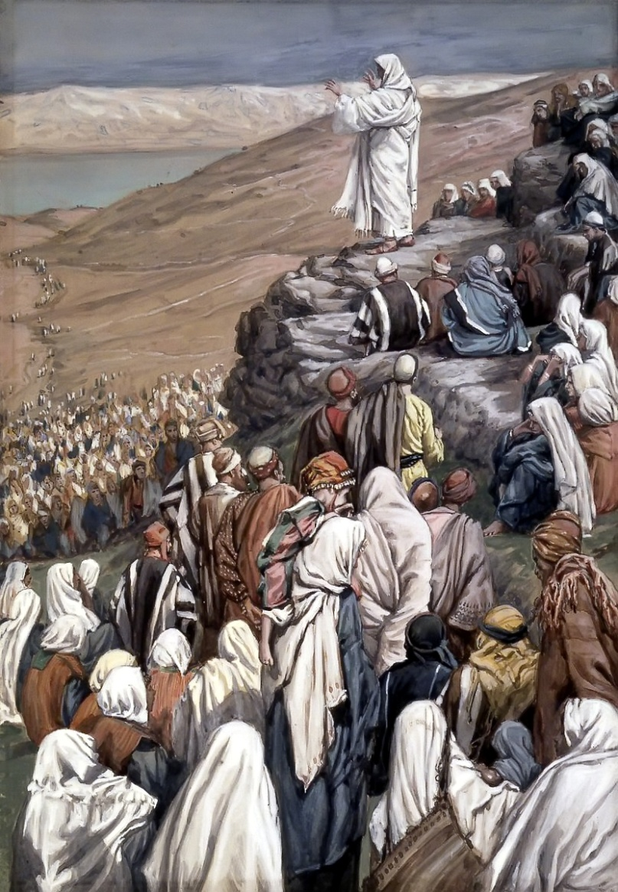
Introduction To The Beatitudes
MATTHEW 4
[25] Great multitudes followed Him—from Galilee, and from Decapolis, Jerusalem, Judea, and beyond the Jordan.
MATTHEW [5:1] And seeing the multitudes, He went up on a mountain, and when He was seated His disciples came to Him. [2] Then He opened His mouth and taught them,

Slide 2
Notes:
In the second year of our Lord's earthly ministry He walked up a hill on the northeast shore of the Sea of Galilee and taught His disciples (Matt 5:1-2).
Moses went up into a mountain to receive the Law; Jesus ascended a mountain explain the Law
As was the custom of Jewish rabbis, Jesus sat down to teach (cf. Luke 4:20).
"The sanctuary for the greatest sermon ever preached was the mountain. As far as we know, this mountain—really a large hill—had no name until Jesus preached there. Until then it had been but one of many hills that slope up gently from the north shore of the Sea of Galilee. What had been simply a mountain among many other mountains now became the mountain, sanctified and set apart by the presence of the Lord. For many centuries the traditional site has been called the Mount of Beatitudes." (MacArthur, Matthew 1-7, 137)
NEXT SLIDE IS A CONTINUATION OF THIS NARATIVE

Slide 3
Notes:
The Mount of Beatitudes overlooks the four-mile long Plain of Gennesaret.
The mountain is topped by a Roman Catholic Franciscan chapel which was built in 1939 with the support of the Italian dictator Benito Mussolini
A Byzantine church building was erected near the current site in the 4th century
As you look over the Sea of Galilee from the Mount of Beatitudes you can see the Cove of the Sower, the place where Jesus told the parable about the man casting seeds into various types of soil (Matt 13:3—9).
You have to wonder what it would have been like to sit on these hills 2,000 years ago and listen to the Son of God explain the "kingdom of Heaven."

Slide 4
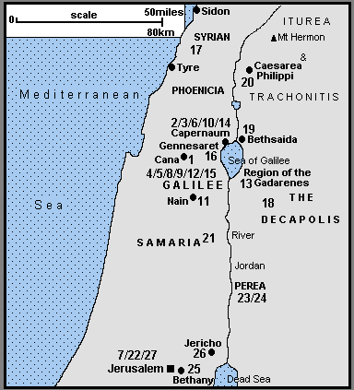
Notes:
Matt. 4:[25] Great multitudes followed Him—from Galilee, and from Decapolis, Jerusalem, Judea, and beyond the Jordan.

Slide 5
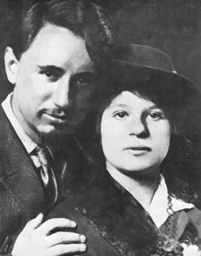
Introduction To The Beatitudes
The famous historian Will Durant
said that in any given generation
only a handful of people make an
impression on the world that lasts
more than a few years. ……
William Durant and
Ariel Durant (1930)
Best known but least followed teachings of Jesus
……
The Beatitudes are a collection of eight
characteristics (qualities of life)
Notes:
"The famous historian Will Durant said that in any given generation only a handful of people make an impression on the world that lasts more than a few years. The person who stands out above all others, he said, is Jesus Christ. Jesus undoubtedly has had the most powerful and permanent influence on the thought of mankind. But, the historian went on to say, His teachings have not had a corresponding effect on man's actions." (MacArthur, Matthew 1-7,137)
CLICK
The Sermon on the Mount is probably the best-known, but least understood and least followed, of all the teachings of Jesus.
CLICK
D. The Beatitudes are a collection of eight characteristics (qualities of life) that separate children of God from the rest of the world (Matt 5:3-12).
BornWilliam James Durant (1885-11-05)November 5, 1885 North Adams, Massachusetts, United StatesDiedNovember 7, 1981(1981-11-07) (aged 96)

Slide 6
Introduction To The Beatitudes
These eight beatitudes describe the blessed state of those who humbly submit themselves to the will of God.
Notes:
These eight beatitudes describe the blessed state of those who humbly submit themselves to the will of God.
F. These are not eight different groups of people (poor, mourners, meek, etc.), but every Christian is meant to manifest every one of these characteristics.
Discussion
I. False Conceptions About The Sermon On The Mount
A. Dispensationalists, such as J.N. Darby, and many evangelicals, believe the teaching in the Sermon on the Mount is for a future "kingdom age/' not for us.
A note on Matthew 5 in the Scefie&lSe/er&Ke New Testament, reads: "For these reasons the Sermon on the Mount in its primary application gives neither the privilege nor the duty of the Church."
However, Jesus spoke in this sermon of the persecution of His disciples would endure as they put the beatitudes into practice (Matt 5:10-12).
However, dispensationalists claim the "kingdom age" will be a time of peace!

Slide 7
Introduction To The Beatitudes
These eight beatitudes describe the blessed state of those who humbly submit themselves to the will of God.
False Conceptions About The Sermon On The Mount
The Sermon On The Mount is for a future
"kingdom age/' not for us.
Notes:
These are not eight different groups of people (poor, mourners, meek, etc.), but every Christian is meant to manifest every one of these characteristics.
False Conceptions About The Sermon On The Mount
A. Dispensationalists, such as J.N. Darby, and many evangelicals, believe the teaching in the Sermon on the Mount is for a future "kingdom age/' not for us.
A note on Matthew 5 in the Scofield Reference New Testament reads: "For these reasons the Sermon on the Mount in its primary application gives neither the privilege nor the duty of the Church."
However, Jesus spoke in this sermon of the persecution of His disciples would endure as they put the beatitudes into practice (Matt 5:10-12).
However, dispensationalists claim the "kingdom age" will be a time of peace!

Slide 8
Introduction To The Beatitudes
These eight beatitudes describe the blessed state of those who humbly submit themselves to the will of God.
False Conceptions About The Sermon On The Mount
is for a future "kingdom age/' not for us.
2. as a pattern for "the social gospel."
3. extension, of the Ten Commandments
4. as a contrast, to the Ten Commandments.
Notes:
Liberal theologians often look upon the Sermon on the Mount as a pattern for "the social gospel.“
Seventh Day Adventists turn the sermon into an extension, of the Ten Commandments that were given on Mt. Sinai.
Many Christians today look at the Sermon on the Mount as a contrast, to the Ten Commandments.
NEXT SLIDE IS A CONTINUATION OF THESE THOUGHTS

Slide 9
Some have turned it into a modern version of the Ten Commandments.
.
They have turned the teachings of Jesus into a series of "Thou shalts" and"Thou shalt nots."
The sermon contains strong meat for mature Christians and it will challenge you as long as you live.
Notes:
Sadly, some Christians turn it into a modern version of the Ten Commandments.
They have done to the Sermon on the Mount what the Jews did to the Law— they have drained the life right out of it.
They have turned the teachings of Jesus into a series of "Thou shalts" and "Thou shalt nots.“
The sermon contains strong meat for mature Christians and it will challenge you as long as you live.

Slide 10
Historical Context
A. In the first century Judea was filled with many problems:
The land was occupied by a tyrannical military government.
It was a world of absolute rulers, the antithesis of democracy
It was a world of persecution—the people were chattel for the Romans.
Taxes consumed a third of their income.
Racial prejudice was prevalent to the point that men no longer knew who their neighbor was (Luke 10:25—29).
Slavery was rampant—there were approximately three slaves to every free man.
Notes:
The Parable of the Good Samaritan
Lk 10[25] And behold, a certain lawyer stood up and tested Him, saying, “Teacher, what shall I do to inherit eternal life?” [26] He said to him, “What is written in the law? What is your reading of it? ” [27] So he answered and said, “ ‘You shall love the LORD your God with all your heart, with all your soul, with all your strength, and with all your mind,’ * and ‘your neighbor as yourself.’ ” * [28] And He said to him, “You have answered rightly; do this and you will live.” [29] But he, wanting to justify himself, said to Jesus, “And who is my neighbor?”

Slide 11
Historical Context
It has been said that the Sadducees bargained with Rome but the Pharisees bargained with God
B. In response to this sad situation, many answers were given by sects of the Jews.
The Zealots, the terrorists of their day, said, "Don't worry about your spiritual life—our hope is military might."
The Sadducees said, "We can only survive by compromising with the world. Be cautious and negotiate the best bargain you can."
The Pharisees said, "Live a clean, ritually pure life (as defined by our Rabbis) and trust in God and He will do the rest.”
They followed human traditions and put a hedge around the Torah.

Slide 12
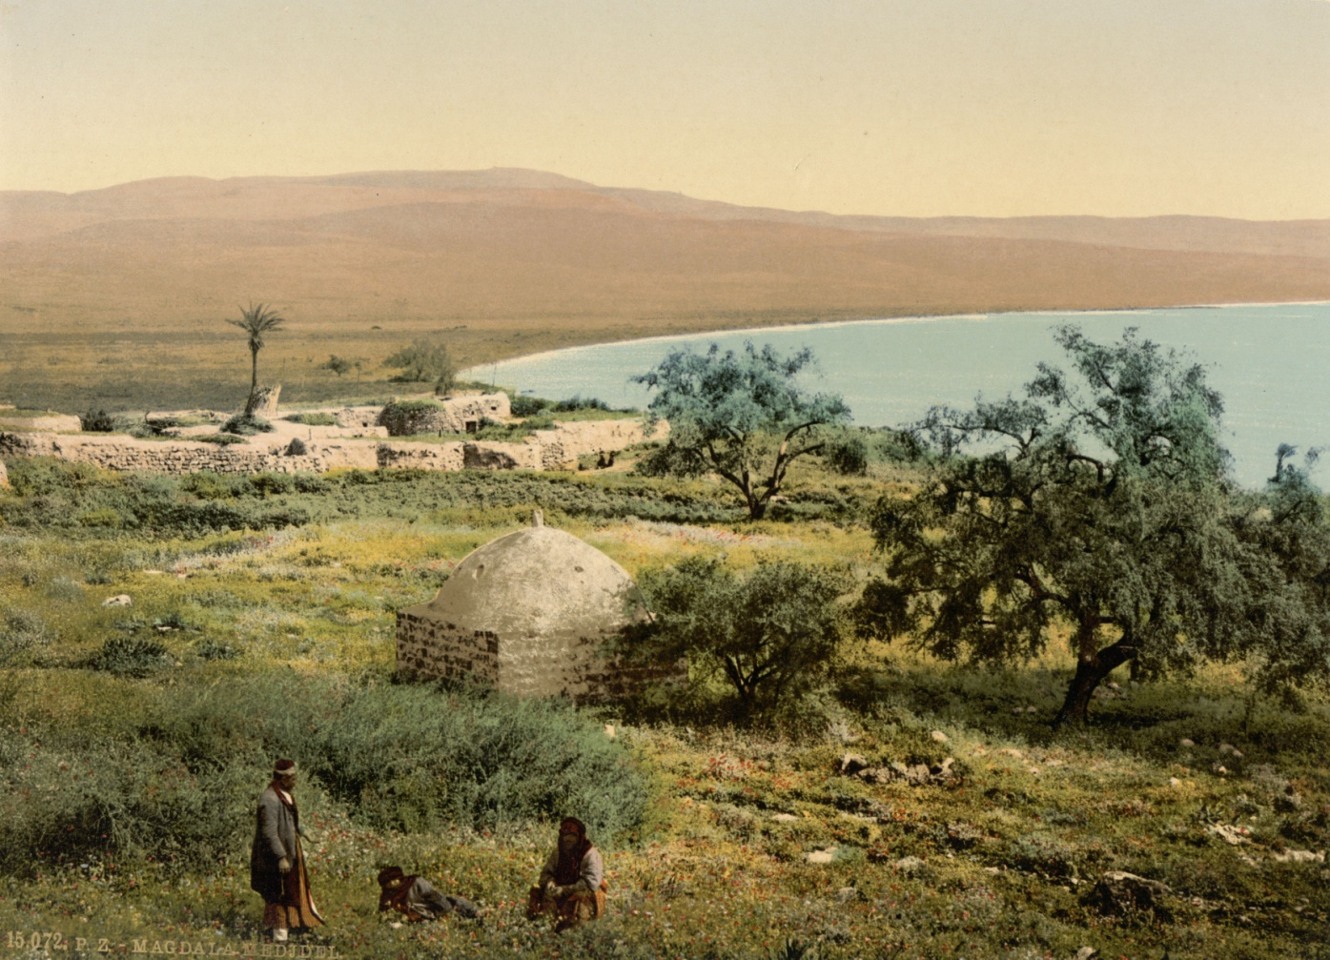
Matthew 9:36 (NKJV)
[36] But when He saw the multitudes, He was moved with compassion for them, because they were weary and scattered, like sheep having no shepherd.
IN THE MIDST OF THE HARSH RULE OF ROME, AND THE
CONFLICTING
VIEWS OF THE
JEWISH PEOPLE
CONCERNING GOD
A LOWLY GALILEAN CARPENTER CLIMBED THE HILLS AND WALKED THE VALLEYS OF JUDEA. HE KNEW THE PEOPLE AND HAD COMPASSION ON THEIR MISERABLE SITUATION.

Slide 13
This sermon was delivered in the second year of Christ's ministry and near the height of His popularity (Matt 4:24).
Matthew 4:24 (NKJV)
[24] Then His fame went throughout all Syria; and they brought to Him all sick people who were afflicted with various diseases and torments, and those who were demon-possessed, epileptics, and paralytics; and He healed them.
Notes:
He had already had two altercations with the Pharisees.
Having rejected the doctrine of the Zealots, Sadducees and Pharisees, Jesus taught about the need for genuine repentance (Matt 4,17).
Consider how the lexicons define the word repent, (Gr. (leTavoeco, metanoeo),
"to change one's mind and purpose" (Liddell and Scott, An Intermediate^ Greek-English Lexicon^).
"have a change of heart, turn from one's sins, change one's
ways" (Newman, A Concise Greek-English Dictionary of the New Testament).
"to change any or all of the elements composing one's life: attitude, thoughts, and behaviors concerning the demands of God for right living" (Goodrick, Kohlenberger and Swanson, Greek to English Dictionary and Index to the NIVNew Testament).

Slide 14
Jesus was asking them to radically change their entire lives and worldview.
Romans 12:1-2 (NKJV)
[12:1] I beseech you therefore, brethren, by the mercies of God, that you present your bodies a living sacrifice, holy, acceptable to God, which is your reasonable service. [2] And do not be conformed to this world, but be transformed by the renewing of your mind, that you may prove what is that good and acceptable and perfect will of God.
Notes:
No one has the right to ask another to change his manner of life, unless he can offer a better way.
When non-Christians visit at some congregations all they see is a group of people with long faces who are about as cheerful as a coroner's inquest.
No one wants a religion that makes people miserable! "However absolute the call to repentance, it was a message of joy because the possibility of repentance exists. Because God has turned to man...man should, may and can turn to God. Hence conversion and repentance are accompanied by joy, for they mean the opening up of life for the one who has turned.
The parables in Lk. 15 bear testimony to the joy of God over the sinner who repents and call on men to share it. God's gift to men in their conversion is life. When the parable of the prodigal son pictures conversion as a return to the Father, it can be said of the man who has repented, This my son was dead, and is alive again* (Lk. 15:24; cf.
32)."

Slide 15
General Observations About The Sermon On The Mount
In this sermon Jesus challenges people to a standard of living that is radically different from anything the world had ever heard before.
This sermon does not say, "live like this and you will be a Christian," but rather, "Because you are a Christian, live like this."
This sermon shows how Christians are meant to live.

