Slide 1
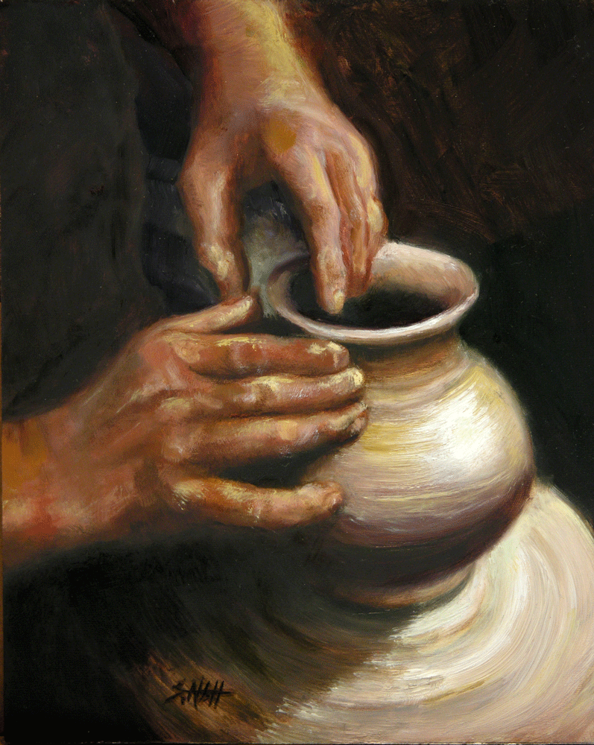
Jeremiah 18:6 (NKJV) “O house of Israel, can I not do with you as this potter?” says the LORD. “Look, as the clay is in the potter's hand, so are you in My hand, O house of Israel!

Slide 2
"Blessed are the poor in spirit, for theirs is the Kingdom of heaven" (Matt. 5:3)
According to Jesus, true happiness is related to some sort of poverty.
are the poor πτωχοὶ ptōchoi 4434
(of one who crouches and cowers, hence) beggarly, poor adjective from ptóssó (to crouch, cower)
Ptochos (used in Matt. 5:3) means absolute
and abject poverty.
Notes:
Introduction
According to Jesus, true happiness is related to some sort of poverty.
The Greeks had two words for poor: penes and ptochos.
A. Penes describes a working man—he had nothing extra, but wasn't destitute.
B. Ptochos (used in Matt. 5:3) means absolute and abject poverty.
The root word means to cower, to be beaten to the knees.
The first man has nothing extra; the second has nothing at all.
III. Jesus had been preaching repentance to large crowds.
A. Beatitudes are in a definite order; they are not haphazardly presented.
B. It is a picture of a man turning to God.
C. No one is in the Kingdom who is not poor in spirit.
This Beatitude is an emptying of one's self; the rest speak of a filling.
Poor
[ A-1,Adjective,G4434, ptochos ] for which See BEG, B, has the broad sense of poor," (a) literally, e.g., Matthew 11:5; Matthew 26:9, Matthew 26:11; Luke 21:3 (with stress on the word, "a conspicuously poor widow"); John 12:5-John 12:6, John 12:8; John 13:29; James 2:2-James 2:3, James 2:6; the "poor" are constantly the subjects of injunctions to assist them, Matthew 19:21; Mark 10:21; Luke 14:13, Luke 14:21; Luke 18:22; Romans 15:26; Galatians 2:10; (b) metaphorically, Matthew 5:3; Luke 6:20; Revelation 3:17. [ A-2,Adjective,G3998, penichros ] akin to B, "needy, poor," is used of the widow in Luke 21:2 (cp. No. 1, of the same woman, in Luke 21:3); it is used frequently in the papyri. In the Sept., Exodus 22:25; Proverbs 28:15; Proverbs 29:7. [ B-1,Noun,G3993, penes ] "a laborer "(akin to penomai, "to work for one's daily bread"), is translated "poor" in 2 Corinthians 9:9. [ C-1,Verb,G4433, ptocheuo ] "to be poor as a beggar" (akin to A, No. 1), "to be destitute," is said of Christ in 2 Corinthians 8:9.

Slide 3
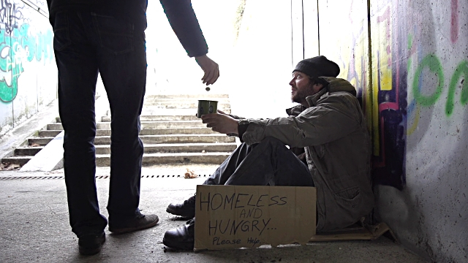
Proverbs 30:7-9 (NKJV)[7] Two things I request of You (Deprive me not before I die):
[8] Remove falsehood and lies far from me; Give me neither poverty nor riches— Feed me with the food allotted to me;
[9] Lest I be full and deny You, And say, “Who is the LORD?” Or lest I be poor and steal, And profane the name of my God.
Notes:
. Misunderstandings About This Text
A. Not talking about material — poverty does not guarantee heaven.
B.Compare with the words of Agar (Prov. 30:7—9).
C."Poor in spirit" does not mean "poor-spirited" either (lack of drive, no enthusiasm, motivation).
D. Jesus was concerned with poverty of spirit—my attitude towards myself.

Slide 4
What Should Our Attitude Be Towards Ourselves?
1 Corinthians 2:1-5 (NKJV)[2:1] And I, brethren, when I came to you, did not come with excellence of speech or of wisdom declaring to you the testimony of God. [2] For I determined not to know anything among you except Jesus Christ and Him crucified. [3] I was with you in weakness, in fear, and in much trembling. [4] And my speech and my preaching were not with persuasive words of human wisdom, but in demonstration of the Spirit and of power, [5] that your faith should not be in the wisdom of men but in the power of God.
2 Corinthians 4:5 (NKJV) For we do not preach ourselves, but Christ Jesus the Lord, and ourselves your bondservants for Jesus’ sake.
Notes:
//. What Should Our Attitude Be Towards Ourselves?
A.The world places a great emphasis on self-reliance, self-confidence.
Lectures by Napoleon Hill, Dale Carnegie and Og Mandino.
A humble politician is said to "lack personality."
Paul said, "We preach not ourselves, but Christ" (2 Cor. 4:5).
Paul would not be accepted by many churches today (1 Cor. 2:1—5).
B."Poor in spirit" is not a suppression of personality; don't be ashamed of your personal abilities or money you have worked for.

Slide 5
Great characters of the Old Testament were "poor in spirit."
EX. 4:[10] Then Moses said to the LORD, “O my Lord, I am not eloquent, neither before nor since You have spoken to Your servant; but I am slow of speech and slow of tongue.”
Isaiah 57:15 (NKJV)
[15] For thus says the High and Lofty One
Who inhabits eternity, whose name is Holy: “I dwell in the high and holy place, with him who has a contrite and humble spirit, To revive the spirit of the humble, And to revive the heart of the contrite ones.
Judges 6:15 (NKJV) So he said to Him, “O my Lord, how can I save Israel? Indeed my clan is the weakest in Manasseh, and I am the least in my father's house.”
Notes:
C. Great characters of the Old Testament were "poor in spirit."
Isaiah (Isa. 57:15).
Gideon (Judges 6:15).
Moses (Ex. 4:10).
Define contrite: feeling or showing regret for bad behavior (Miriam Webster Dictionary)
PSALMS 51:[16] For You do not desire sacrifice, or else I would give it; You do not delight in burnt offering.
[17] The sacrifices of God are a broken spirit, A broken and a contrite heart— These, O God, You will not despise.
Solomon (1 Kings 3:5-9).SEE NEXT SLIDE

Slide 6
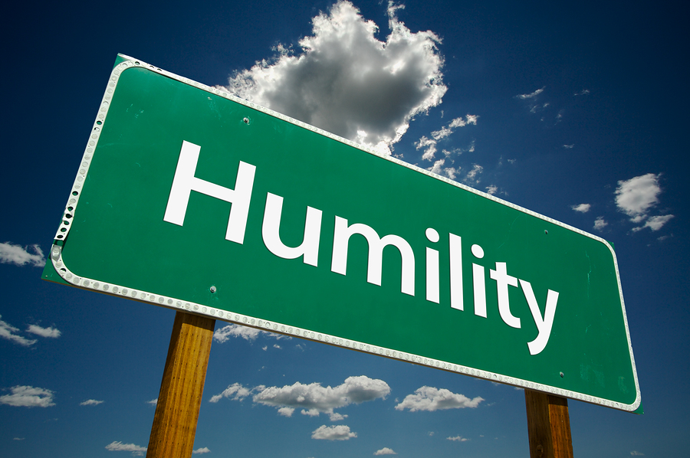
1 Kings 3:5-9 (NKJV)[5] At Gibeon the LORD appeared to Solomon in a dream by night;
and God said, “Ask! What shall I give you?”
[6] And Solomon said: “You have shown great mercy to Your servant David my father, because he walked before You in truth, in righteousness, and in uprightness of heart with You; You have continued this great kindness for him, and You have given him a son to sit on his throne, as it is this day
Notes:
CONTINUED ON NEXT SLIDE

Slide 7
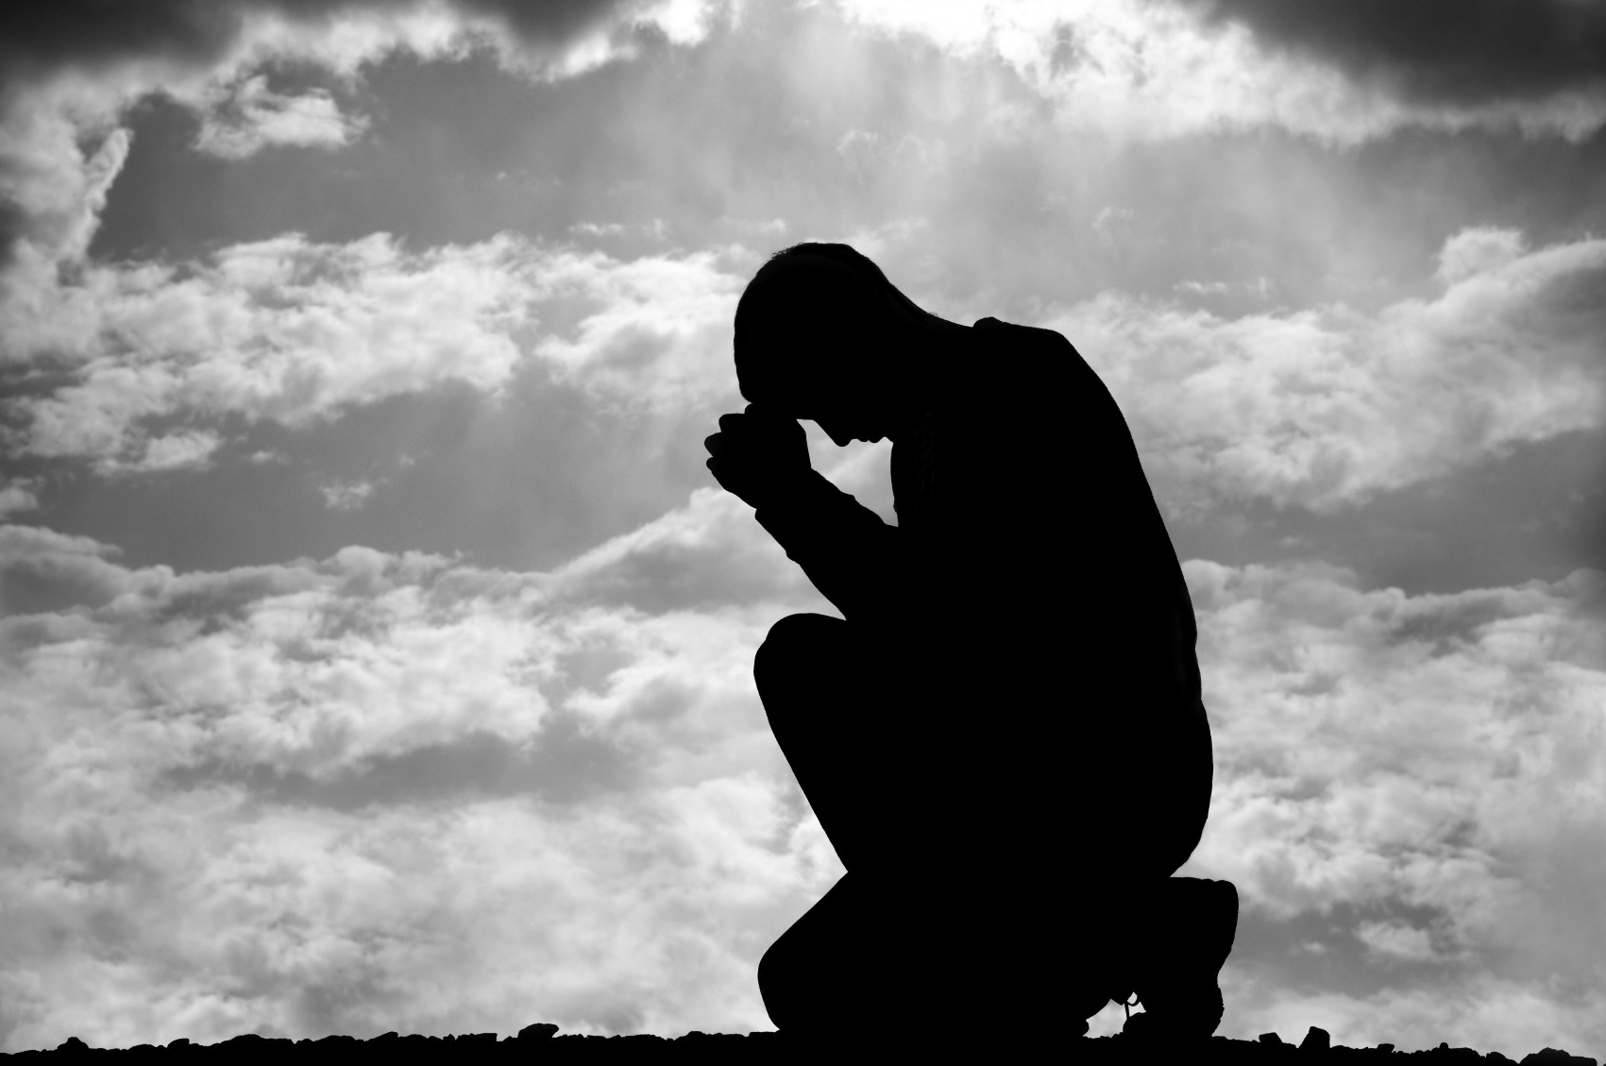
[7] “Now, O LORD my God, You have made Your servant king instead of my father David, but I am a little child;
I do not know how to go out or come in. [8] “And Your servant is in the midst of Your people whom You have chosen, a great people, too numerous to be numbered or counted. [9] “Therefore give to Your servant an understanding heart to judge Your people, that I may discern between good and evil. For who is able to judge this great people of Yours?”

Slide 8
What Is Meant By "Poor In Spirit?"
1 Corinthians 3:18-19 (NKJV)
[18] Let no one deceive himself. If anyone among you seems to be wise in this age, let him become a fool that he may become wise. [19] For the wisdom of this world is foolishness with God. For it is written, “He catches the wise in their own craftiness” ;
Psalms 8:4-5 (NKJV)
[4] What is man that You are mindful of him, And the son of man that You visit him?
[5] For You have made him a little lower than the angels, And You have crowned him with glory and honor.
Notes:
What Is Meant By "Poor In Spirit?"
A.CLICK Complete absence of pride and self reliance (1 Cor. 3:18).
Consciousness of the fact that we are nothing before God (Psa. 8:4).
We will not rely on ancestry, our financial reserves or education,
Paul had all of these things—yet counted them as "rubbish" and a hindrance to his real purpose in life—service to Christ. "To be poor in spirit is to have a humble opinion of ourselves; to be sensible that we are sinners, have no righteousness of our own; to be willing to be saved only by the rich grace and mercy of God; to be willing to be where God places us, to bear what he lays on us, to go where he bids us, and to die when he commands; to be willing to be in his hands, and to feel that we deserve no favor from him. It is opposed to pride, vanity, and ambition." (Albert Barnes, Matthew and Mark, p. 43). "To be poor in spirit (Matt. 5:3) is to be vacant of self and waiting for God. To have no confidence in the flesh; to be emptied of self-reliance; to be conscious of absolute insufficiency; to be thankfully dependent on the life energy of the living God—.that is poverty of spirit; and it has been characteristic of some of the noblest, richest, most glorious natures that have ever trodden the shores of Time. Happy are they who are conscious of a poverty which only the grace of God can change into wealth..."

Slide 9
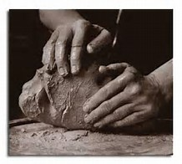
CONCLUSION
How do we become "poor in spirit?"
A. Not by going out of the world (the sin of Monasticism),
B. Rather, by looking to God and His word—see what He expects from us.
C. We come empty, hopeless, naked and vile (cf. Eph. 2:12).
D. Like the wonderful song Rock Of Ages says, "In my hand no price I bring, simply to Thy cross I cling.”
Notes:
"This Child is destined for the fall and rising of many in Israel" (Luke 2:34).
The order: emptying before filling; repentance before conversion.
We must have a recognition of our unworthiness before God before we can accept His salvation.
Our songs echo the same thought, like Have Thine Own Way.
Conclusion
I. How do we become "poor in spirit?"
A.Not by going out of the world (the sin of Monasticism),
B.Rather, by looking to God and His word—see what He expects from us.
C.We come empty, hopeless, naked and vile
( Ephesians 2:11-13 (NKJV)
[11] Therefore remember that you, once Gentiles in the flesh—who are called Uncircumcision by what is called the Circumcision made in the flesh by hands— [12] that at that time you were without Christ, being aliens from the commonwealth of Israel and strangers from the covenants of promise, having no hope and without God in the world. [13] But now in Christ Jesus you who once were far off have been brought near by the blood of Christ.
D.Like the wonderful song Rock Of Ages says, "In my hand no price I bring, simply to Thy cross I cling.
“CLICK FOR FOLLOWING POINTS
E.God turns us into His special people.(I Pet 2:9-10).
II.The Kingdom of God can be yours when you realize your own utter helplessness without God and learn to trust and obey.

Slide 10
CONCLUSION
E. God turns us into His special people.
(I Pet 2:9-10).
The Kingdom of God can be yours when you realize your own utter helplessness without God and learn to trust and obey.
Notes:
1 Peter 2:9-10 (NKJV)
[9] But you are a chosen generation, a royal priesthood, a holy nation, His own special people, that you may proclaim the praises of Him who called you out of darkness into His marvelous light; [10] who once were not a people but are now the people of God, who had not obtained mercy but now have obtained mercy.

